Slide 1
LITERATURE SURVEY
FAKE LOGO DETECTION SYSTEM
Team No :08
ARCHANA M – 20BCS013
KHAVYA - 20BCS055
HARINISHA - 20BCS035
Faculty Name:
V.SENTHIL KUMAR AP II/CSE
Kumaraguru College of Technology/
Coimbatore
Engineering Clinic V
Sem V |CSE | Kumaraguru College of Technology

Slide 2
Presentation Outline
TEAM NO :08
Literature Survey
Inference
Problem Statement
Dataset Used
Block diagram for Proposed System
Front End & Back End
Timeline using Gantt chart
References

Slide 3

LITERATURE SURVEY FROM THE YEAR
2017-2021

Slide 4
Literature Survey TITLE AND AUTHOR | Problem Statement: | In view of determining of the authenticity of a logo, a precise extraction of features is crucially important for any automated recognition system to succeed. Here in this proposed work, identification of fake logos are done by fusion based approach of features from SIFT and SURF which considerably does better compared to the existing methods.
Identification of Fake VS Original logos using Deep Learning Ranjith K ,Sharath Kumar Y | Proposed Solution: | SIFT approach, the image feature extraction, it accepts the image and transform that to the "large collection of local feature vectors". All such component vectors are invariant to the scaling, turn if not the interpretation of the picture. These approaches share several features by responses of neurons in the primate vision. The SIFT calculation uses the 4 phase distinguished approaches for helping the extraction of these highlights:
 | Output: | The key purpose of the Convolution is to extract the features from the given input image in case of a ConvNet. The spatial relationship between pixels is conserved through the convolution by learning the features of image by means of small squares of the input data.
 | Merits: | The originality of the logo can be detected more precisely using different optimal features extracted. The work can be enhanced to multi classification of logos for documents to classify the sub classes. Further the tree indexing method can be applied for effective retrieval system
 | Demerits: | Limited the detection to just 4 different categories of general classes like Renault, Volks wagon, Rolls Royce, and Honda brand logos
 | Future Scope: | The originality of the logo can be detected more precisely using different optimal features extracted. The work can be enhanced to multi classification of logos for documents to classify the sub classes. Further the tree indexing method can be applied for effective retrieval system.

Slide 5
Literature Survey TITLE AND AUTHOR | Problem Statement: | This paper deals with finding fake logo by matching and recognizing it with the original logo. This is done by dividing the image of logo into rows and columns and thus each cell has its index value
Finding Fake Logo Using CDS Logo Detection And Recognition Algorithm B. Suganya and A.C. Santha Sheela | Proposed Solution: | Recognition which is based on the definition of “Context-Dependent Similarities”, the matching is done by dividing the image of logo into rows and columns.
 | Output: | When this process is done the matching will be very accurate. The solution is proved to be highly effective and responds to the requirements of logo detection and recognition in real world images. The probability success of matching and detection is high.
 | Merits: | the inclusion of the information about the spatial configuration the ability to control the influence of the context and the regularization the tolerance to different aspects
 | Demerits: | The drawback of this method is that it assumes that a logo picture is fully visible in the image, is not corrupted by noise and is not subjected to transformations. According to this, they cannot be applied to real world images. The major limitation of this approach is image resolution and their solution has revealed to be very sensitive to occlusions.
 | Future Scope: | Interest points and local descriptors were used by many authors and appear much more appropriate to support detection and recognition of graphic logos in real world images.

Slide 6
Literature Survey TITLE AND AUTHOR | Problem Statement: | Automatic Fake Logo detection and brand recognition with its original Logo.
Fake Logo detection and brand recognition with its original Logo. Yousaf,Waqas,Umar, Arifª ,Shirazi, Syed Hamad^{a;} | Proposed Solution: | To address this problem, Patch-CNN is proposed for logo recognition which uses small patches of logos for training to solve the problem of misclassification. The classification is accomplished by dividing the logo images into small patches and threshold is applied to drop no logo area according to ground truth.
 | Output: | So far, the technique has attained accuracy equals to 0.9901 with acceptable training and testing loss on the dataset used in this work.
 | Merits: | The architectures of AlexNet and ResNet are also used for logo detection. We propose a segmentation free architecture for the logo detection and recognition.
 | Demerits: | The main problem to logo detection is intra-class variation, which is generated by the variation in image quality and degradation. The problem of misclassification also occurs while having tiny logo in large image with other objects.
 | Future Scope: | This Logo Detection project aims to help users identify forgeries by analysing the logo on the product. Along with helping users identify the logo.

Slide 7
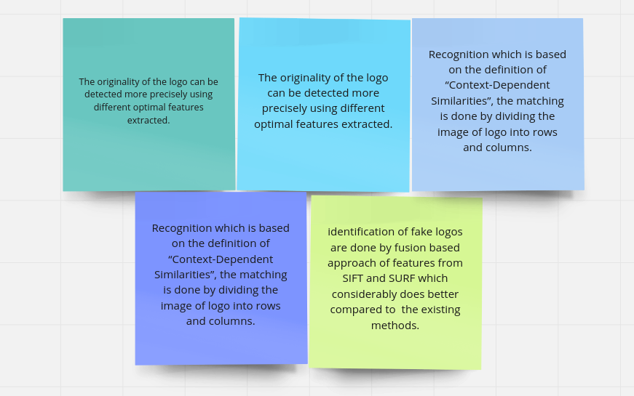
Inference From literature Survey

Slide 8
PROBLEM STATEMENT: Consumers get cheated out of their hard-earned money as they end up shelling out an exorbitant amount of money for a mere counterfeit.

Slide 9
Datasets
Original logo to define the brand recognition
Input logo/image to detect whether the logo is fake or not.

Slide 10

Gantt Chart :

Slide 11
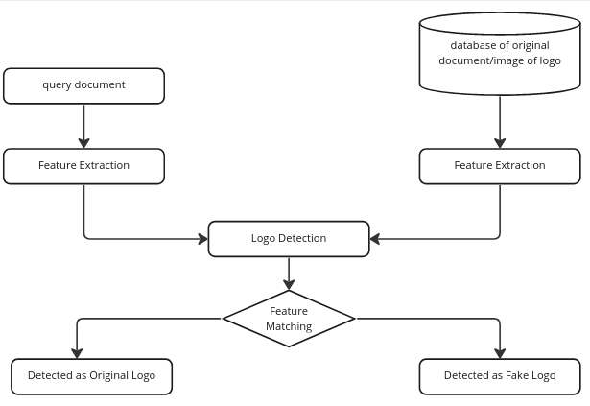
Block diagram of Proposed System

Slide 12
System Requirements:
Windows 7 or higher
XAMPP Server
Python
Text Editor (Notepad++ )

Slide 13
References
https://en.wikipedia.org/wiki/Object_detection
https://ieeexplore.ieee.org/document/9440236
https://www.mifratech.com/public/blogpag/Online+Fake+Logo+Detection+System
https://www.ijser.org/researchpaper/Finding-Fake-Logo-Using-CDS-LogoDetection-And-Recognition-Algorithm.pdf
https://ieeexplore.ieee.org/document/9391842

Slide 14


